Slide 1
WL Warriors: A DSS For eco-friendly car purchase
Debora Maia Silva
Prasad Gujela
Shan Lin
Taeyong Kim
Ke Yin

Slide 2
Business problem
The development of clean vehicles and fuel technologies can provide consumers with an affordable, available means of reducing transportation-related air pollution and climate change emissions.
But, how can consumers find out the eco-friendly options from tons of car models?
Create a DSS for consumers to identify the eco-friendliest model that matches their requirements.
For consumers: make better comparison with different car models by the eco-friendly performance
For manufacturers: increase revenue & reduce cost

Slide 3
Analytics problem
How can we find out the best model to fit necessary variables and match customer’ needs?

Slide 4
Data selection

Slide 5
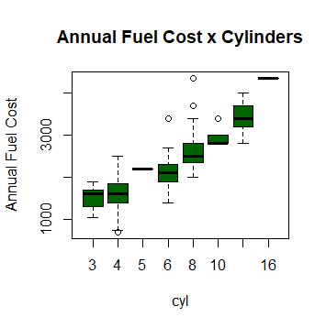
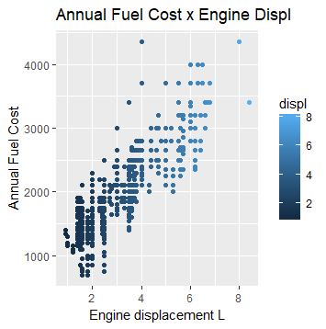
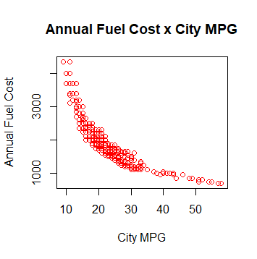
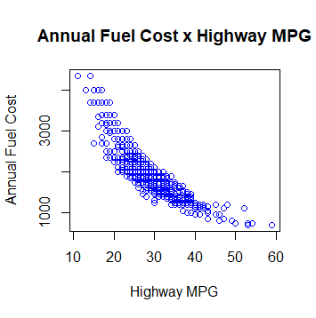
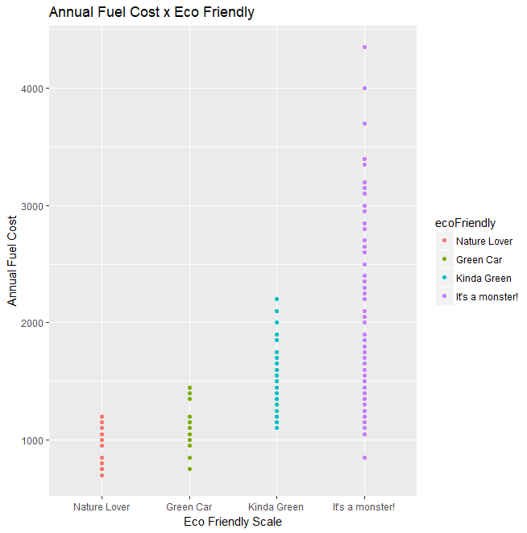

Slide 6
Model Building

Slide 7
Demo of our dss app

Slide 8
Future Improvements

Slide 9
Thank you and questions?

